Slide 1

Course introduction
Management Application

Slide 2

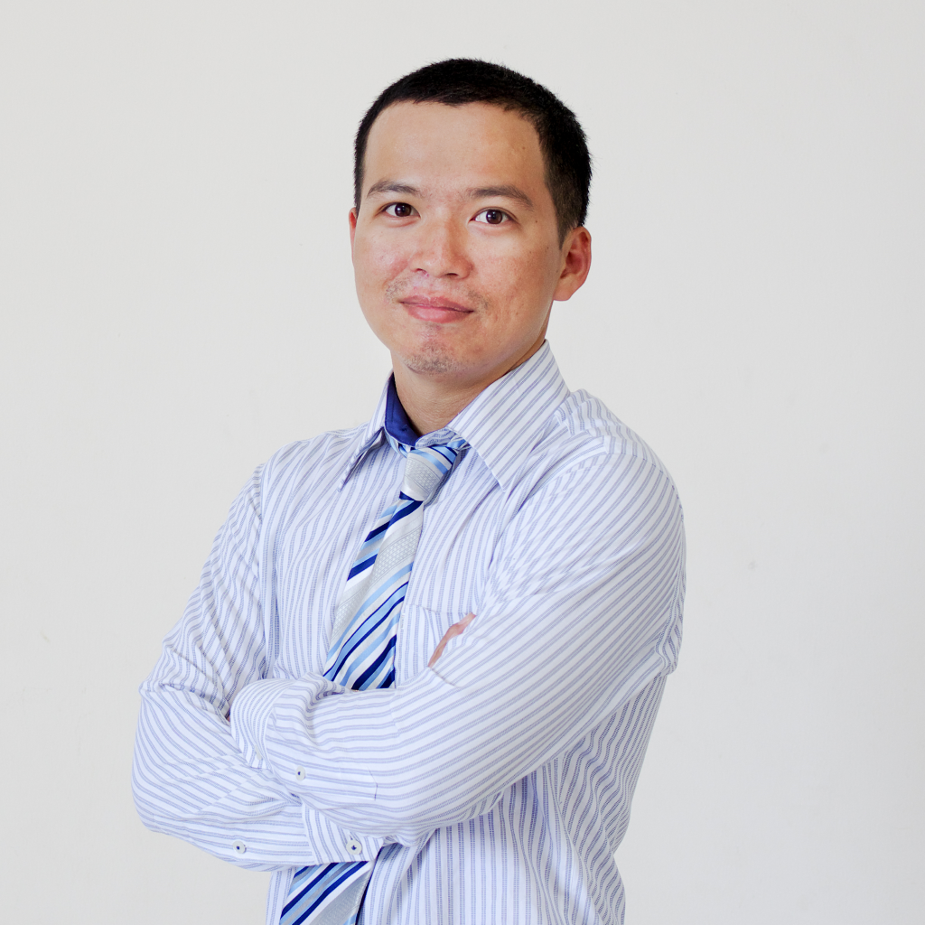
Lecturer information
Trần Duy Quang
tdquang@fit.hcmus.edu.vn
My skills
Windows programming C++/C#
Android (Kotlin) & iOS (Swift)
Web fullstack: node.js, vue, react

Slide 3

Course’s objectives
After finishing the course, the students can
Understand characteristics of Windows applications
Create simple applications in C++ & C# WPF

Slide 4

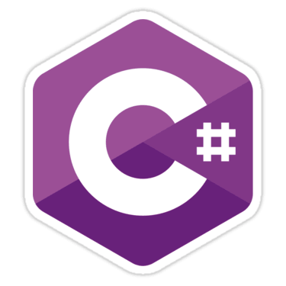
Weapon of choice
WPF
Visual Studio 2017 Community
Other versions are okay as long as clearly writen in readme file

Slide 5

Topics
Basic C# & OOP
Controls: creation & handling events
Passing windows between screens
Handle mouse & keyboard
File system
GDI+
Dynamic link libray
Multithreading
Clipboard
Hook

Slide 6

Grading
In-class activities: 15%
Work in group of 2, present a given topic in 15 min - > 5 min quiz
Weekly Homework: 25%
3 Projects: 40%
File system, GDI+, Hook
Final writing: 20% (Must attend)

Slide 7

Deliverables
source code (cleaned)
Release (exe)
Readme.txt (or md)
youtube link
Default wallpaper, no sound
If file size is > 12MB, can submit Google drive or Dropbox link

Slide 8

Materials for C#
Illustrated C# 7, 5th Edition, Apress, 2018
Pro C# 7, 8th Edition, Apress 2017
Windows 10 Development with XAML & C# 7, 2nd Edition, Apress, 2017

Slide 9
Question?

Slide 10
Quiz
How many points will you get for the project?
What should you do when the submitted file size is too big?
Can you obmit the final writing?

